Slide 1
Energy-based GAN
Hung-yi Lee
Notes:
http://www.inference.vc/are-energy-based-gans-actually-energy-based/
VGAN — Generative Adversarial Networks as Variational Training of Energy Based Models
Original Energy-based GAN
Improved Began
EGAN calibrated,
MAGAN: Margin Adaptation for Generative Adversarial Networks
Margin :
LS GAN x 2
Gang of GANs

Slide 2
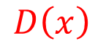
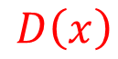

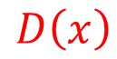
Original Idea
Discriminator
Data (target) distribution
Generated distribution
Discriminator leads the generator
$$D\left(x\right)$$
$$D\left(x\right)$$
$$D\left(x\right)$$
$$D\left(x\right)$$
Is it the only explanation of GAN?
Notes:
When the data distribution and generated distribution is the same.
The output of discriminator will be flat everywhere.
However, discriminator is often used in pre-training.
It contains useful information.
We always use the discriminator obtained in the last iteration as the initialization of the next step.

Slide 3
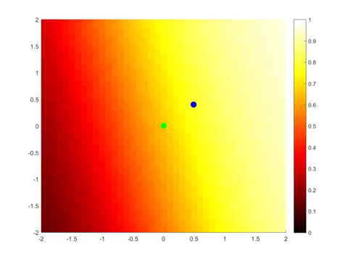
Original GAN
The discriminator is flat in the end.
Source: https://www.youtube.com/watch?v=ebMei6bYeWw (credit: Benjamin Striner)

Slide 4
Evaluation Function
We want to find an evaluation function F(x)
Input: object x, output: scalar F(x) (how “good” the object is)
E.g. x are images
Real x has high F(x)
F(x) can be a network
We can generate good x by F(x):
Find x with large F(x)
How to find F(x)?
object
x
Evaluation Function F
scalar
F(x)
F(x)
In practice, you cannot decrease all the x other than real data.
real data

Slide 5
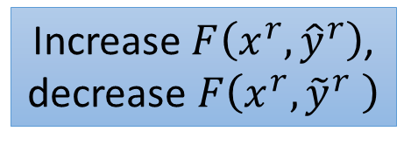
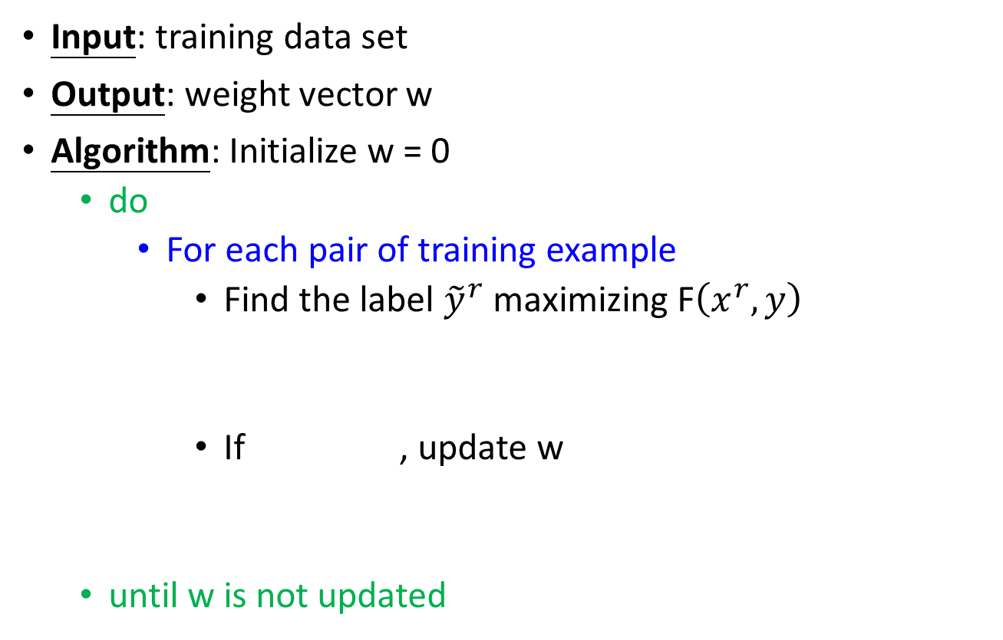
Evaluation Function - Structured Perceptron
Input: training data set
Output: weight vector w
Algorithm: Initialize w = 0
do
For each pair of training example
Find the label ${\tilde{y}}^{r}$ maximizing F$\left(x^{r},y\right)$
If , update w
until w is not updated
Can be an issue
Increase $F\left(x^{r},{\hat{y}}^{r}\right)$, decrease $F\left(x^{r},{\tilde{y}}^{r} \right)$
We are done!
Notes:
contrastive
Question 1 and 2 is solved.
Important: if the weight if not update, end the algorithm

Slide 6
How about GAN?
$$F\left(x\right)$$
Generator is an intelligent way to find the negative examples.
“Experience replay”, parameters from last iteration
$$F\left(x\right)$$
In the end ……
$$F\left(x\right)$$
$$F\left(x\right)$$

Slide 7
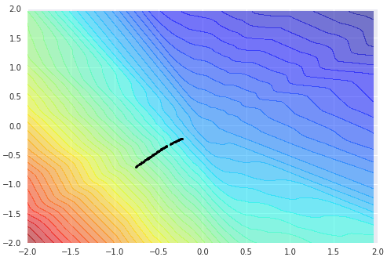
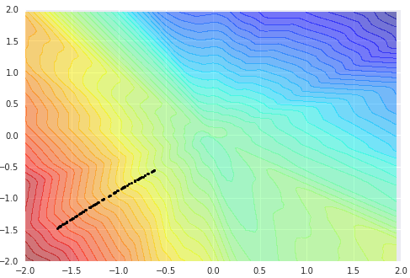
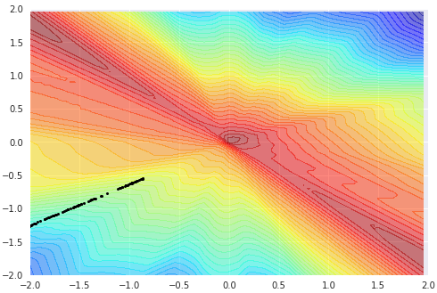
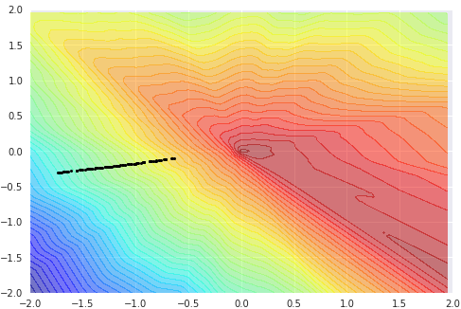
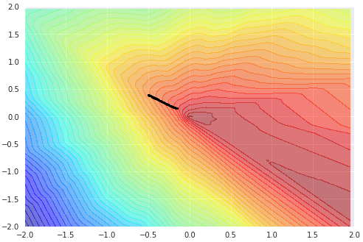
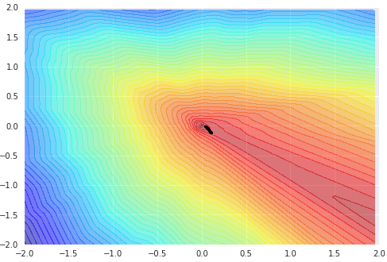
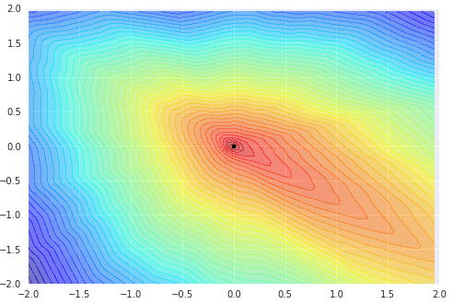
P_{data} = “origin”
G = 1 hidden layer (100)
D = 1 hidden layer (100)

Slide 8
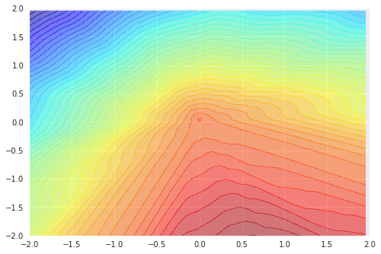
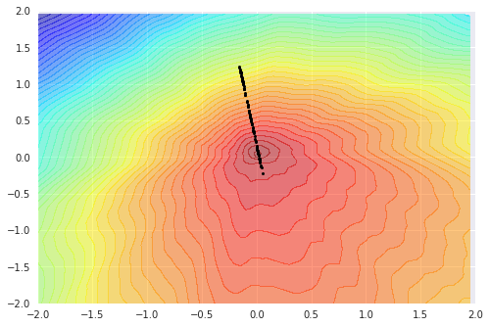
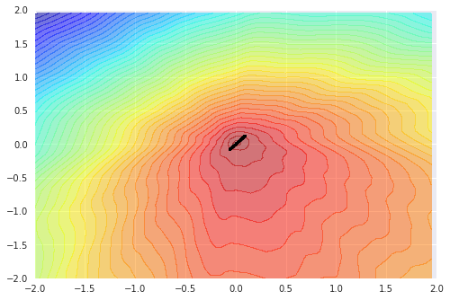
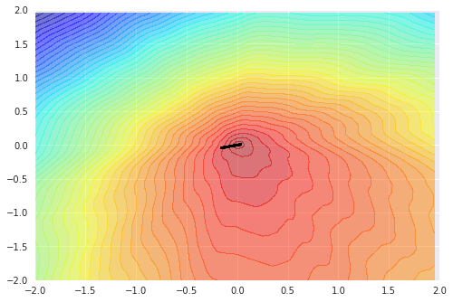
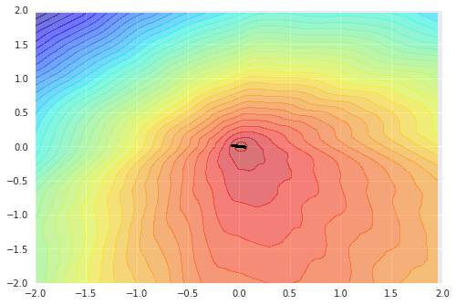
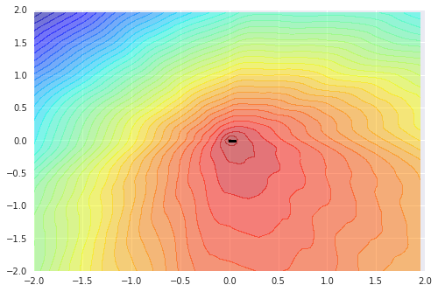
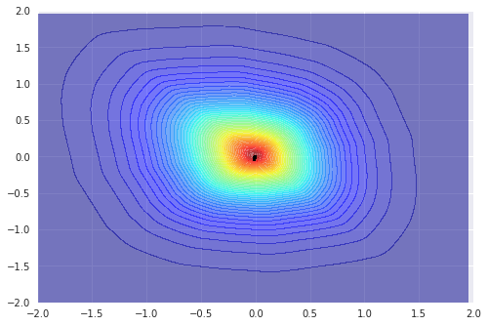
100 iterations on G
100 iterations on D

Slide 9
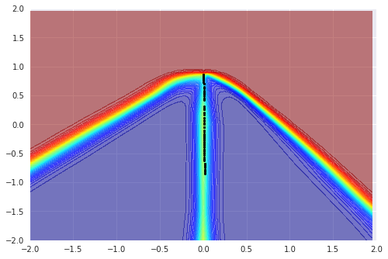
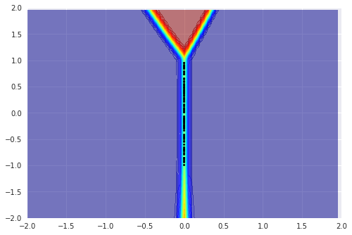
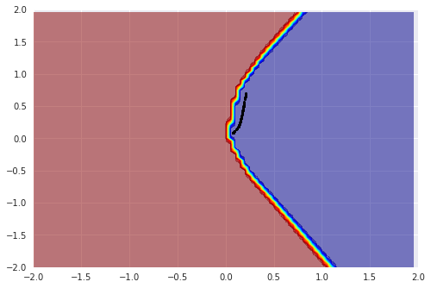
P_{data} = “line”
100 iterations on D
G = 1 hidden layer (100)
D = 1 hidden layer (100)
G = 2 hidden layer (100)
G = 1 hidden layer (100)
D = 1 hidden layer (100)
D = 2 hidden layer (100)

Slide 10
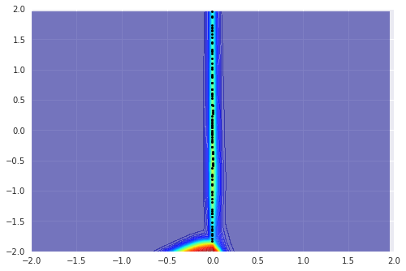
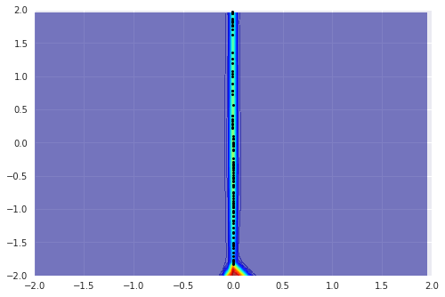
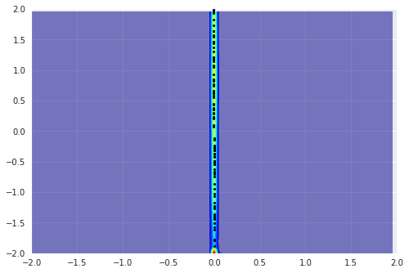
P_{data} = 1-D Gaussian
100 iterations on D
G = 2 hidden layer (100)
D = 1 hidden layer (100)

Slide 11
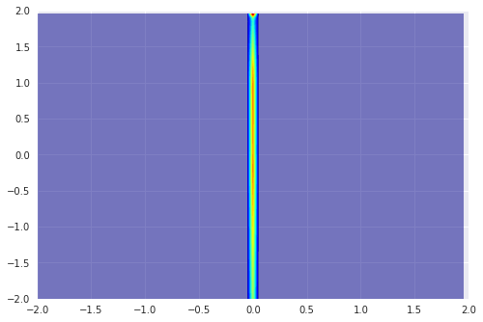

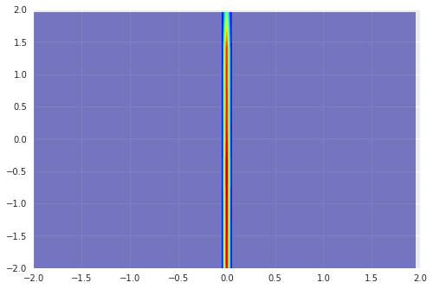
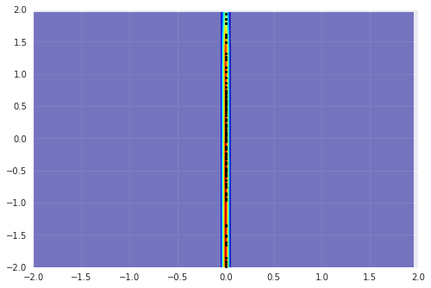

Slide 12
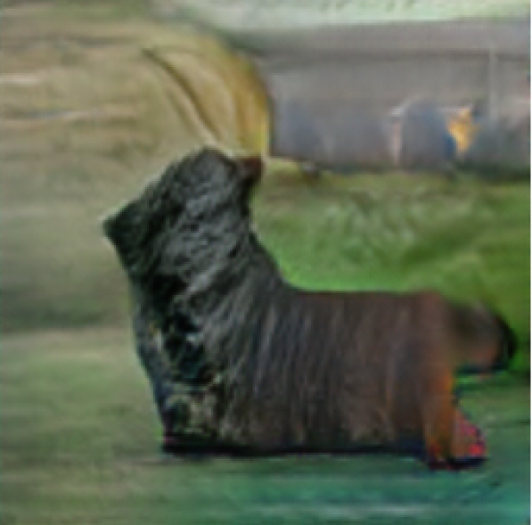
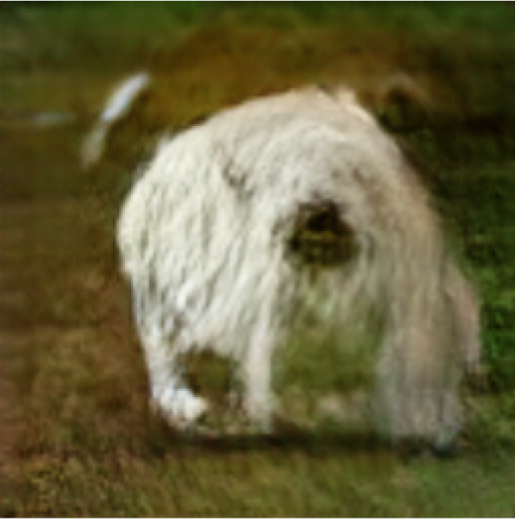
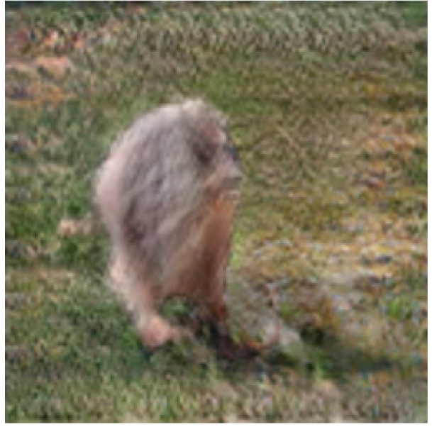
Energy-based GAN (EBGAN)
Viewing the discriminator as an energy function (negative evaluation function)
Auto-encoder as discriminator (energy function)
Loss function with margin for discriminator training
Generate reasonable-looking images from the ImageNet dataset at 256 x 256 pixel resolution
without a multiscale approach
Junbo Zhao, Michael Mathieu, Yann LeCun, “Energy-based Generative Adversarial Network”, arXiv preprint, 2016

Slide 13
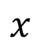
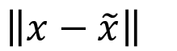
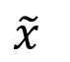
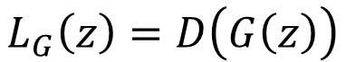
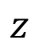
EBGAN
Discriminator
GE
EN
DE
$$z$$
$$x$$
$$\tilde{x}$$
$$\left\|x−\tilde{x}\right\|$$
scalar
Autoencoder
Sample real example x
Sample code z from prior distribution
Update discriminator D to minimize
$$L_{D}\left(x,z\right)=D\left(x\right)+max\left(0,m−D\left(G\left(z\right)\right)\right)$$
Sample code z from prior distribution
Update generator G to minimize
$$L_{G}\left(z\right)=D\left(G\left(z\right)\right)$$

Slide 14
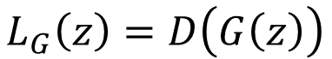
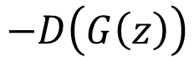
EBGAN
Discriminator
GE
EN
DE
$$z$$
$$x$$
$$\tilde{x}$$
$$\left\|x−\tilde{x}\right\|$$
scalar
Autoencoder
Discriminator D:
$$L_{D}\left(x,z\right)=D\left(x\right)+max\left(0,m−D\left(G\left(z\right)\right)\right)$$
Generator G:
$$L_{G}\left(z\right)=D\left(G\left(z\right)\right)$$
$$−D\left(G\left(z\right)\right)$$
m
Hard to reconstruct, easy to destroy
gen
real
gen

Slide 15
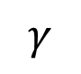
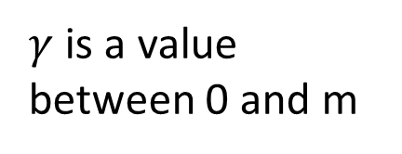

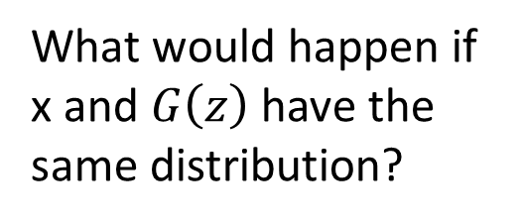

EBGAN
Discriminator
GE
EN
DE
$$z$$
$$x$$
$$\tilde{x}$$
$$\left\|x−\tilde{x}\right\|$$
scalar
Autoencoder
$$γ$$
$$γ$$
Discriminator D:
$$L_{D}\left(x,z\right)=D\left(x\right)+max\left(0,m−D\left(G\left(z\right)\right)\right)$$
Generator G:
$$L_{G}\left(z\right)=D\left(G\left(z\right)\right)$$
For auto-encoder, the region for low value is limited.
What would happen if x and $G\left(z\right)$ have the same distribution?
large
large
m
$$γ$$
$γ$ is a value between 0 and m
real = gen

Slide 16
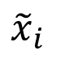
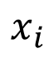
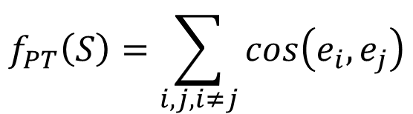
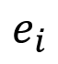
More about EBGAN
EN
DE
$$x_{i}$$
$${\tilde{x}}_{i}$$
$$e_{i}$$
Pulling-away term for training generator
Better way to learn auto-encoder?
If auto-encoder only learns to minimize the reconstruction error of real images
Can obtain nearly identity function (not properly designed structure)
Giving larger reconstruction error for fake images regularized auto-encoder
Given a batch $S=\left\{⋯x_{i}⋯x_{j}⋯\right\}$ from generator
$$f_{PT}\left(S\right)=\sum_{i,j,i≠j}{cos\left(e_{i},e_{j}\right)}$$
To increase diversity

Slide 17
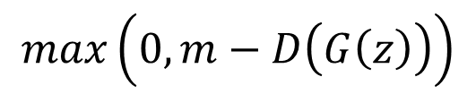
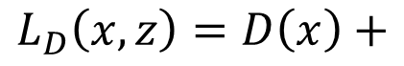
Margin Adaptation GAN (MAGAN)
Dynamic margin m
As the generator generates better images
The margin becomes smaller and smaller
$$L_{D}\left(x,z\right)=D\left(x\right)+$$
$$max\left(0,m−D\left(G\left(z\right)\right)\right)$$

Slide 18
Loss-sensitive GAN (LSGAN)
Reference: Guo-Jun Qi, “Loss-Sensitive Generative Adversarial Networks on Lipschitz Densities”, arXiv preprint, 2017
LSGAN allows the generator to focus on improving poor data points that are far apart from real examples.
Connecting LSGAN with WGAN
LSGAN
Assuming D(x) is the energy function
Discriminator minimizing:
$$D\left(x\right)+max\left(0,Δ\left(x,G\left(z\right)\right)+D\left(x\right)−D\left(G\left(z\right)\right)\right)$$

Slide 19
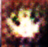


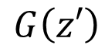




D(x)
$$G\left(z\right)$$
$$Δ\left(x,G\left(z\right)\right)$$
$$G\left(z′\right)$$
$$Δ\left(x,G\left(z′\right)\right)$$
$$x$$
LSGAN
Assuming D(x) is the energy function
Discriminator minimizing:
$$D\left(x\right)+max\left(0,Δ\left(x,G\left(z\right)\right)+D\left(x\right)−D\left(G\left(z\right)\right)\right)$$
Notes:
G learns to generate images minimizing D
https://zhuanlan.zhihu.com/p/26007545

Slide 20














$$F\left(x,y\right)$$
$$F\left(x,y\right)$$
$$F\left( \right)$$
$$∆\left( \right)$$
$$F\left( \right)$$
margin
$$F\left( \right)$$
$$∆\left( \right)$$
$$F\left( \right)$$
margin
$$F\left( \right)$$
$$F\left( \right)$$
$$F\left( \right)$$
$$F\left(x^{n},{\hat{y}}^{n}\right)≥F\left(x^{n},y\right)$$
$$F\left(x^{n},{\hat{y}}^{n}\right)−F\left(x^{n},y\right)≥∆\left({\hat{y}}^{n},y\right)$$

Slide 21
Boundary Equilibrium Generative Adversarial Networks (BEGAN)
Ref: David Berthelot, Thomas Schumm, Luke Metz, “BEGAN: Boundary Equilibrium Generative Adversarial Networks”, arXiv preprint, 2017
Auto-encoder based GAN
Not from celebA
Notes:
Instead of using margin, this paper uses another approach
a new approximate convergence measure

Slide 22










BEGAN
Discriminator
GE
EN
DE
$$z$$
$$x$$
$$\tilde{x}$$
$$\left\|x−\tilde{x}\right\|$$
scalar
Autoencoder
For discriminator:
$$L_{D}=D\left(x\right)−k_{t}D\left(G\left(z\right)\right)$$
For generator:
$$L_{G}=D\left(G\left(z\right)\right)$$
For each training step t:
$$k_{t+1}=k_{t}+λ\left(γD\left(x\right)−D\left(G\left(z\right)\right)\right)$$
$k_{t}$ increase
$$\frac{D\left(G\left(z\right)\right)}{D\left(x\right)}<γ$$
If $γD\left(x\right)>D\left(G\left(z\right)\right)$

Slide 23




BEGAN
$$\frac{D\left(G\left(z\right)\right)}{D\left(x\right)}<γ$$
For discriminator:
$$L_{D}=D\left(x\right)−k_{t}D\left(G\left(z\right)\right)$$
For generator:
$$L_{G}=D\left(G\left(z\right)\right)$$
For each training step t:
$$k_{t+1}=k_{t}+λ\left(γD\left(x\right)−D\left(G\left(z\right)\right)\right)$$

Slide 24


陳柏文 (大四) 提供實驗結果 (using CelebA)

Slide 25











